Slide 1
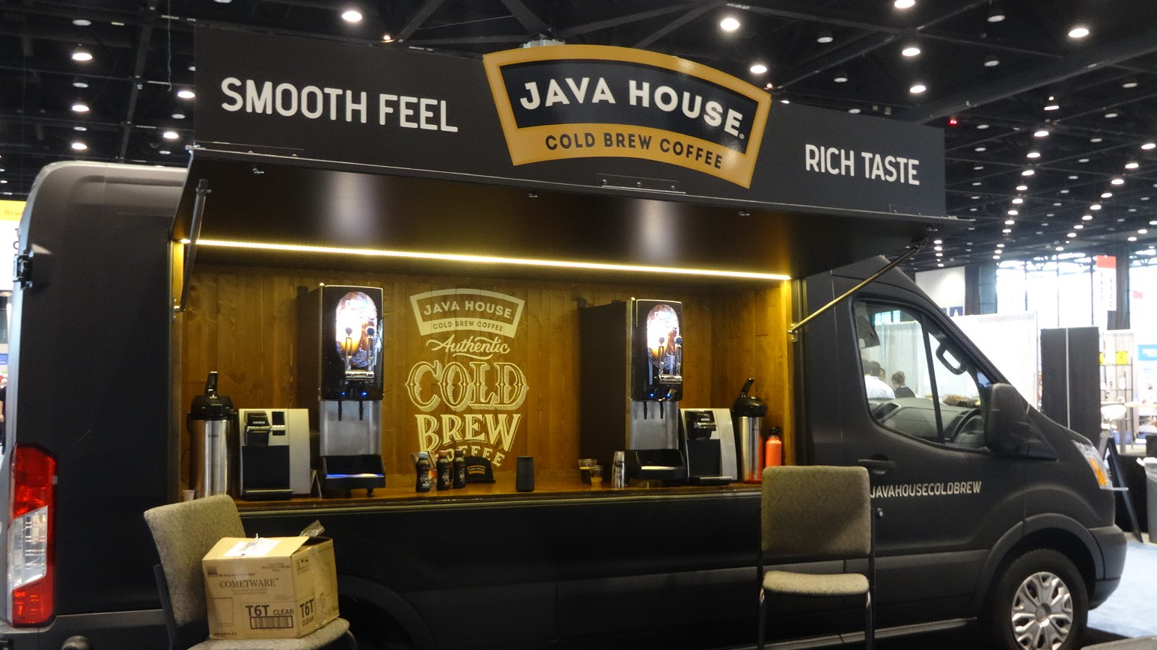
.
Food Truck Management System

Slide 2

Introduction
In our busy lives we sometimes may not spend too much time making food at home. And sometimes like we will just chill while having outside food. Some people like a variety of food items. There can be times when we want to dine early in the morning and there are no eateries open late at night.But we can always get food from trucks. To make life easier, we considered ordering food from trucks online.

Slide 3

Objective of the project
In our project there are three modules : Food truck, delivery boy , customer. The food truck can register into the website with their details like name , email, phone and password into the website. The food truck needs to provide a verification code to verify the account.The truck can login to the website.The food truck will update the timings like opening time and closing time. The food truck will add the food categories to provide the menu. And also can view the food categories which are added. The food truck will add the food items to provide menu. The food truck can view the added food items .The truck can enable or disable the food items.The customer can register to the website with their details like name,email,phone number, password and address.The customer can login to the website with credentials.The customer can view the available trucks.The customer can view the food truck based on location. The customer can view the food items in the website which are added by the food truck. The customer can search the food items and can add the food items to the cart.The customer can view the cart and can place the order with payment.

Slide 4
Continue…
The customer can view the orders. The customer can also cancel their orders before cooking.The food truck can view the order placed by the customer.The food truck should mark the order status as “cooking” while preparing the food.The food truck should mark the order status as “cooked” when food is prepared.The Delivery boy get registered and can login to the website. The food truck will assign the food orders to the delivery boys. The delivery boy will receive the delivery request.The delivery boy will accept the delivery request and then reach the food trucks.The food truck will mark the delivery status as “picked up”.The delivery boy will deliver the order to the customer. The delivery boy will make the status as “delivered to customer”. The customer will confirm the received order by making status as “order received”. The customer can provide the review and rating for the received orders.The customer can view the order history. The food truck can view the order history.

Slide 5
Team Members
Member 1: DIVYA TEJASWI EJJUROTHU 700745894
Working with the database development to design tables and database ER diagrams. The project developer uses the MySQL workbench database server.
Member 2-3: VAMSI DOSAPATI 700740054 , DIVYANJALI MAKKENA 700759648
Developers collaborate with a back-end developer to create code and logical components.Using the Mysql database server with the flask framework.
Member 4-5: SRILAKSHMI THRIVENI 700759664, NAGA SAI LAKSHMI TRIPURANENI 700759299
Working with on frontend developers to produce HTML,CSS and Bootstrap

Slide 6
Database Description:
Objective:
In our Project there are food_truck, truck_timings, Categories, food_items, customers, Customer_orders, customer_order_items, review and delivery_boy tables. The food_truck will register on the website by giving details like food_truck_title, name, email, password, phone and verification_status these are all stored in the food_truck table. The food_truck login to the website through their credentials like email and password. The food_truck will add the truck_timings by giving from_time, to_time, date, location and food_truck_id is the foreign key comes from the food_truck table these are all stored in the truck_timings table.The food_truck will add the categories by giving category_name and food_truck_id is the foreign key comes from the food_truck table these are all stored in the categories table. The food_truck will add the food_items by giving food_item_name, price, quantity, units, picture, status, description and category_id if the foreign key comes from the categories table; these are all stored in the food_items table.

Slide 7
The delivery_boy will register into the website by giving name, email, password, phone, verification_status and address_proof in the delivery_boy table.The customer will register into the website by giving their details like name, email, password, phone, gender, address and verification_status these are all stored in the customers table. The customer login to the website through their credentials like email and password. The customer will create the cart in that cart containing the status, date and customer_id, delivery_boy_id, food_truck_id, truck_timing_id are the foreign keys; these are all stored in the customer_orders table. The customer will select the order items by giving their quantity and customer_order_id, food_item_id are the foreign keys; these are all stored in the customer_order_items table.

Slide 8

Complexity
In our project ,the transaction management technique is used to collect payment.The food items are ordered by the customer. After you have a paid, you can place your order.

Slide 9
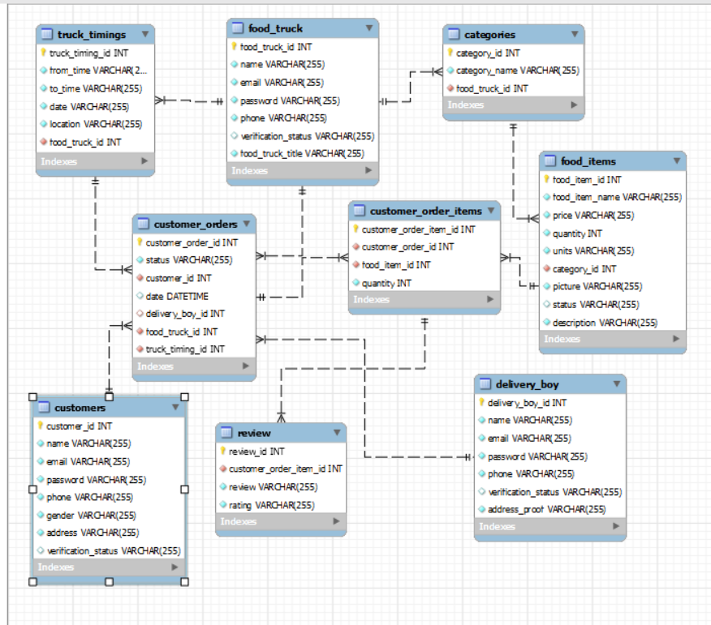
ER Diagram

Slide 10
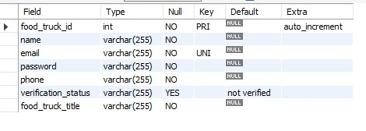
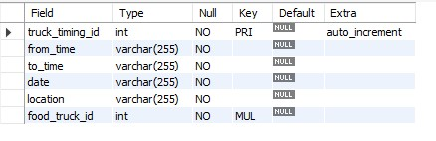
Schema Design
Food Truck:
Truck Timings:

Slide 11

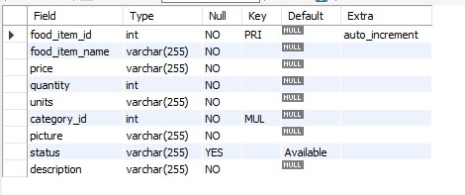
Food Categories:
Food Items:

Slide 12
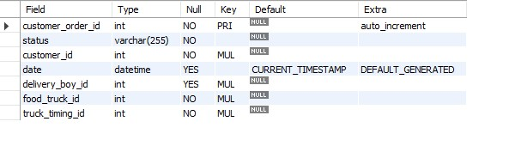
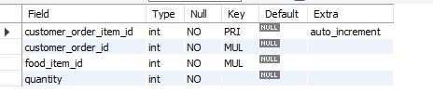
Customer orders:
Customer order_items:

Slide 13
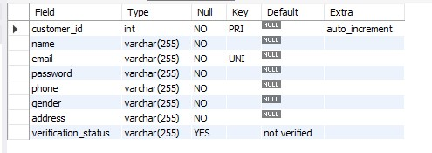
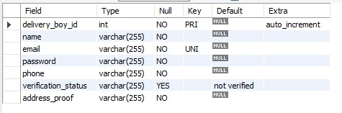
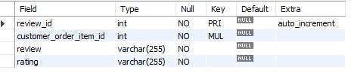
Customer:
Delivery boy:
Review:

Slide 14
Back-end Requirements
Database Engine:
The basic functionality enabling mysql to work with and process data is provided by database engines.MySQL storage engines are components that conduct SQL operations on various table types.The MySQL workbench server is used in the database in this project.
Crud Operations:
The four basic processes that a software program should be able to do are referred to us crud.Users in such apps must be able to create data,access the data in the UI reading the data,update or edit the data, and remove the data.

Slide 15

Create: The CREATE operation in crud performs exactly what is name suggests.To create is to INSERT in a SQL database.The insert() method is used to generate objects in a NoSQL database like MongoDB.
Read:The READ operations grants access to the UI’s inputs.
Update: The UPDATE methods allows you to change existing data.UPDATE is used to update an entry in a SQL database.
Delete: To delete means to remove an entry from the UI and the database.

Slide 16

Front-end Requirements
User Interface:
The technical implementation of the software’s user interface(UI) is referred to as front-end development. In our project, we used front-end technologies such as HTML,CSS,Bootstrap and javascript. HTML is the industry standard markup language for developing web pages.CSS is the programming language used to style a web pages.CSS is used to styles colors, fonts,sizes, and background images.Bootstrap is used to design navbars and menus for web pages.

Slide 17

Deployment Requirements
Cloud Deployment:AWS EC2 is a cloud computing service that allows Amazon web services clients to launch,execute,and terminate applications.It serves as a framework for developing,delivering,and scaling web applications.AWS is designed to be the most flexible and secure cloud computing platform available today.This is known as cloud computing.The AWS cloud comprises a broad range of global cloud-based goods such as computing, storage, databases, analytics, networking,mobile, developer tools,management tools,IOT,security and business applications that are offered on-demand and with pay-as-you-go pricing.

Slide 18

Security Measures
A web application is a computer program that runs on a server.Users gain access to these resources via a network or the internet.The administrator is logged in to the website using default credentials such as a valid email address and password.The user is logged in with the default credentials,such as email and password.
Accessibility:Amazon web services (AWS) is a cloud computing service that allows users to rent virtual computers on which to run their own computer programs. Amazon Elastic compute cloud (Amazon EC2)is a web service that provides safe,resizable processing capability in the cloud.
To construct an EC2,the public DNS web link will be opened in the website.

Slide 19
Timeline
OCT WEEK-1: Our team has five members.
1-tech leader, 2-Database development 3-4 Back-end Development
5-Front-end development.
OCT WEEK-2: No classes
OCT WEEK-3: Discuss the project plan.
Nov WEEK-1: Proposal Presentation (10-15 min)
Nov WEEK 2-3: Project Implementation
Nov WEEK-4:Final presentation(15-20 min)

Slide 20


